Slide 1
Enterprise Kubernetes Logging & Monitoring
Observability in VMware PKS
Denny Zhang
Staff Engineer
VMware, Cloud Native BU
11/12/2018

Slide 2
Problem Space
Existing Solutions
VMware Solution
Q & A

Slide 3
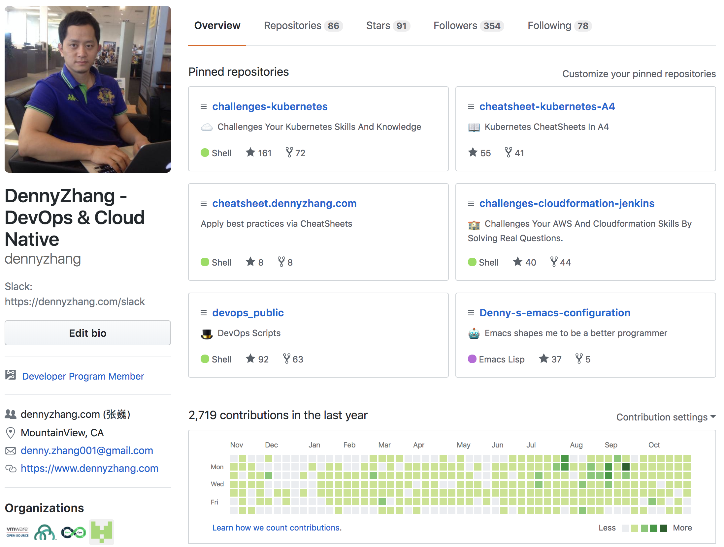
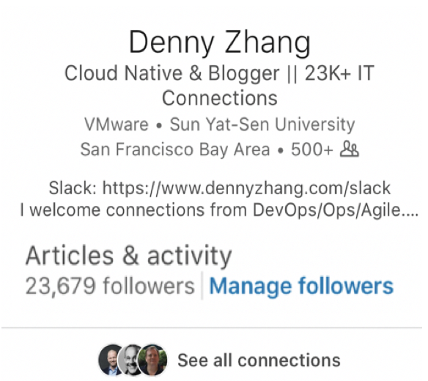

About Me
Kubernetes
DevOps
Blogger
OpenSource
GitHub LinkedIn Blog

Slide 4
Problem Space
Business values for logging and monitoring
Trouble Shooting
Monitoring
Resource Utilization
Audit & Compliance

Slide 5
Data Models In Logging & Monitoring
Events
Logging
Alerts
Metrics
Reports

Slide 6
Data Models Convention
Log format: RFC-5424

Slide 7
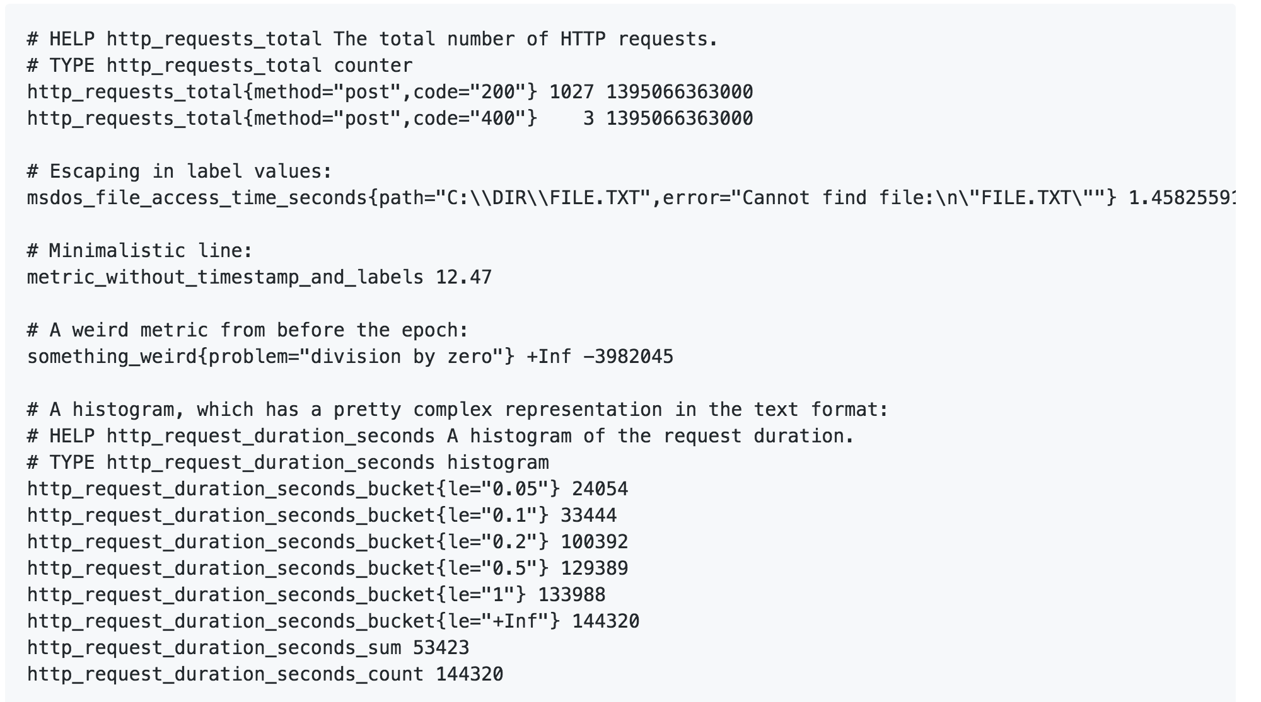
Data Models Convention
Metric format: Prometheus metrics? Kubernetes Open Metrics?

Slide 8

Existing Container Logging Solution
EFK: tail log file

Slide 9
Existing Container Monitoring Solution
Nagios/Zabbix: agent base

Slide 10
Existing Container Monitoring Solution
Prometheus GAP: exporter base + pull model

Slide 11
Problem Solved?

Slide 12
New Problems When Moving To Container World
The foundation has changed!
 | VM World | Container World
When process die/restart | Log file still there | Pod deleted, log file deleted
When process run | Write log to file | Log prints to stdout/stderr
When process deploy | One service for one VM | Co-located, shared, elastic

Slide 13
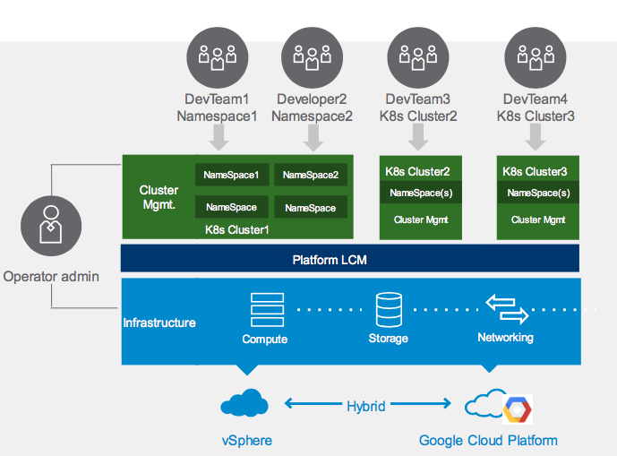
Challenges
Logging – Horizontal partition
Can’t mix:
Different k8s clusters
Different namespaces

Slide 14


Challenges
Logging - Vertical partition
Data sources from different layers
Different layers have different domain knowledgebase
Infra
Nodes
K8S
Containers
Apps
Platform
Reliability Engineer
Application
Dev/Ops Owner
vRops
Wavefront
vRLI
14

Slide 15
Challenges
Fail to get all unnecessary logs
Log-agent is too slow for pod events
Not all log streamed to pod stdout/stderr

Slide 16
Challenges
Fail to get log fast enough
Co-located: Lots of Pods in one k8s worker VM
Noisy neighbors: Back-pressure

Slide 17
VMware Solution
Benefits we want to achieve
Built-in VMware Solution for administrators
Namespace multi-tenancy for developers
Bring your own solutions

Slide 18
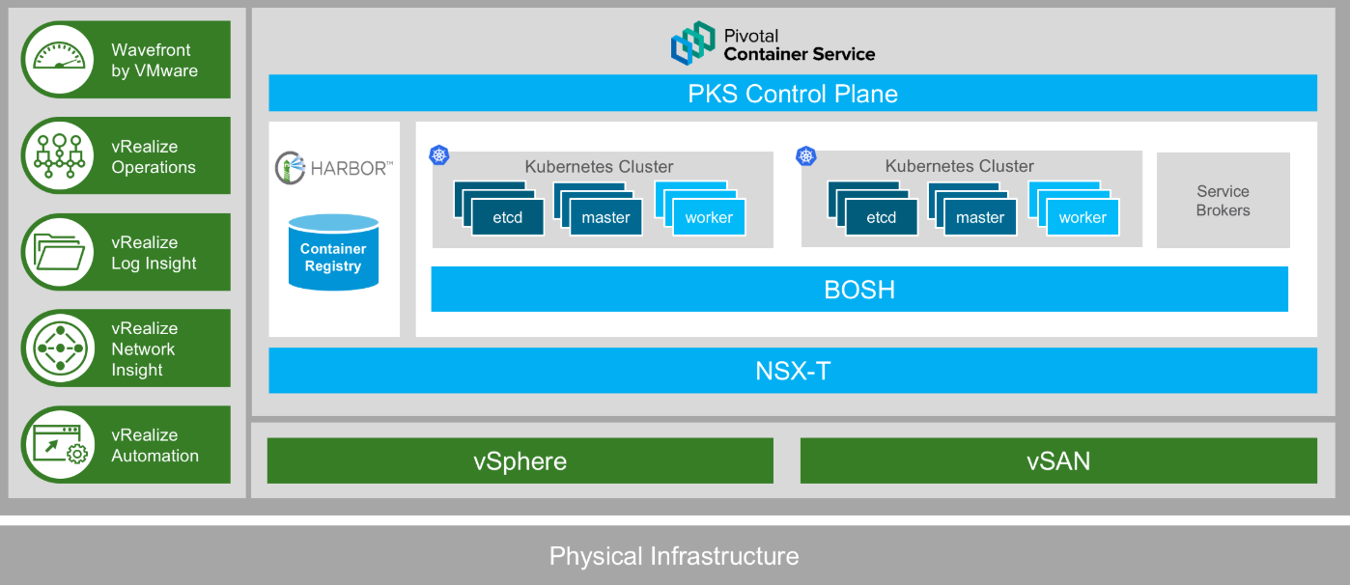
PKS Architecture
See the big picture

Slide 19
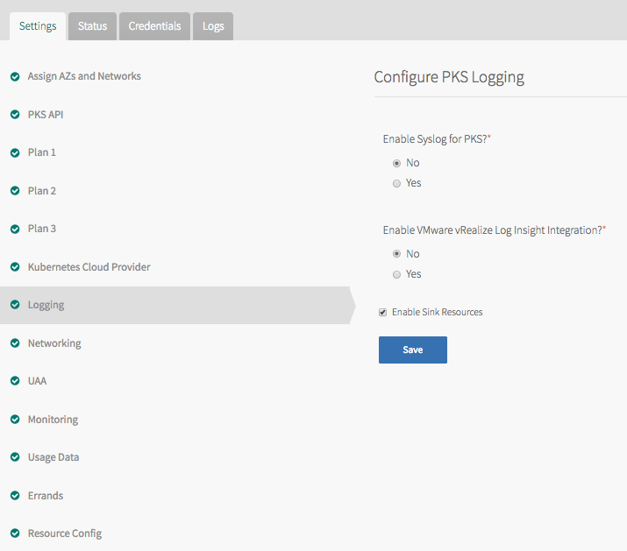
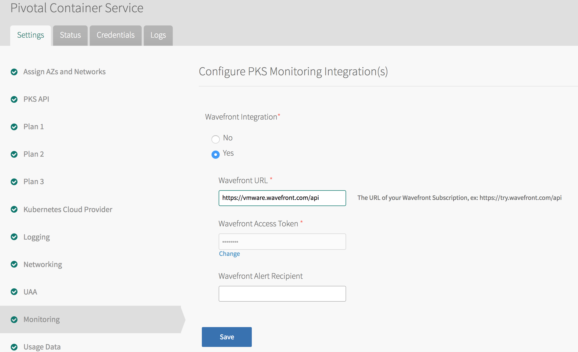
VMware Logging & Monitoring
Easy to configure + work out-of-box
1
2
3

Slide 20
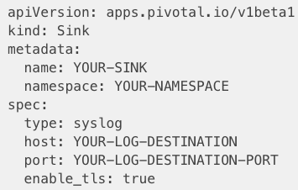
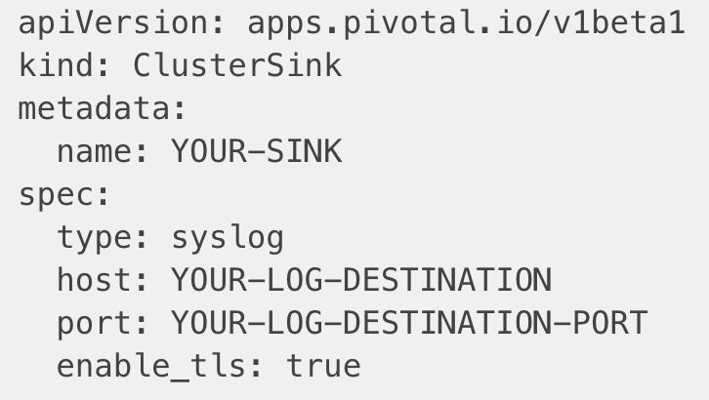
Workload Logging & Monitoring
Configure in k8s cluster level and namespace level
kubectl apply –f ns-sink.yml
kubectl apply –f cluster-sink.yml

Slide 21
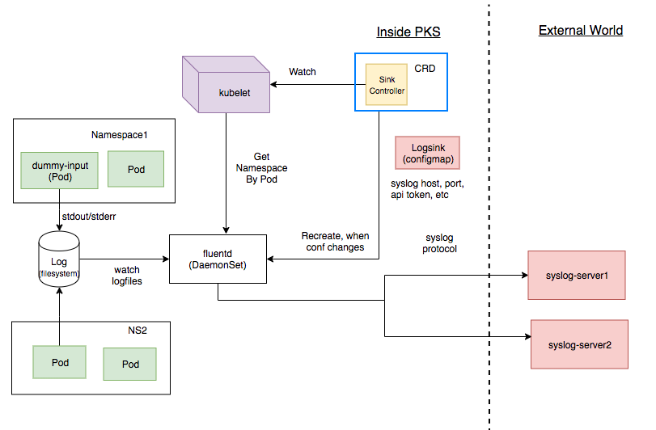
Workload Logging & Monitoring
Namespace multi-tenancy via k8s CRD

Slide 22
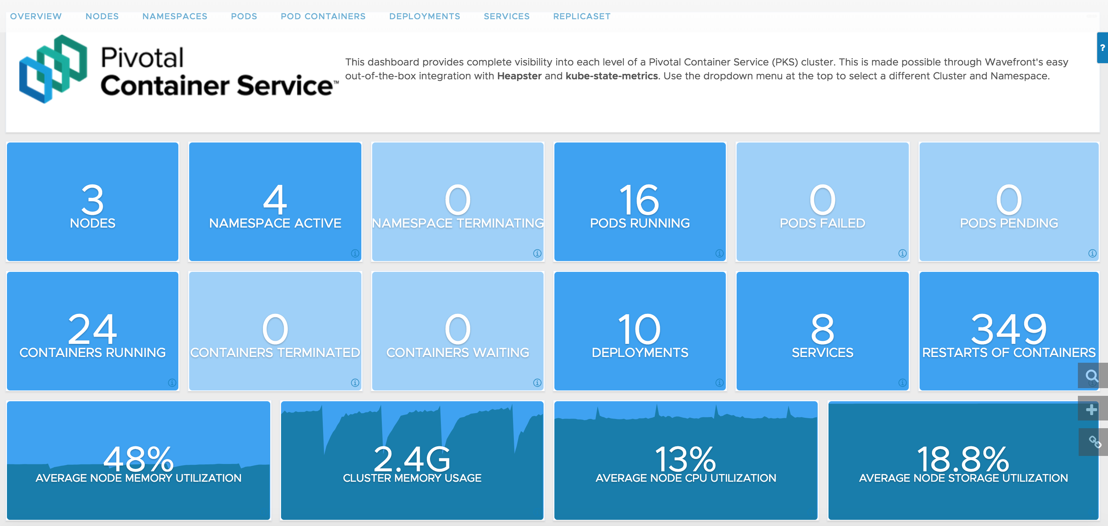
VMware Solution – Wavefront
Easy to use

Slide 23
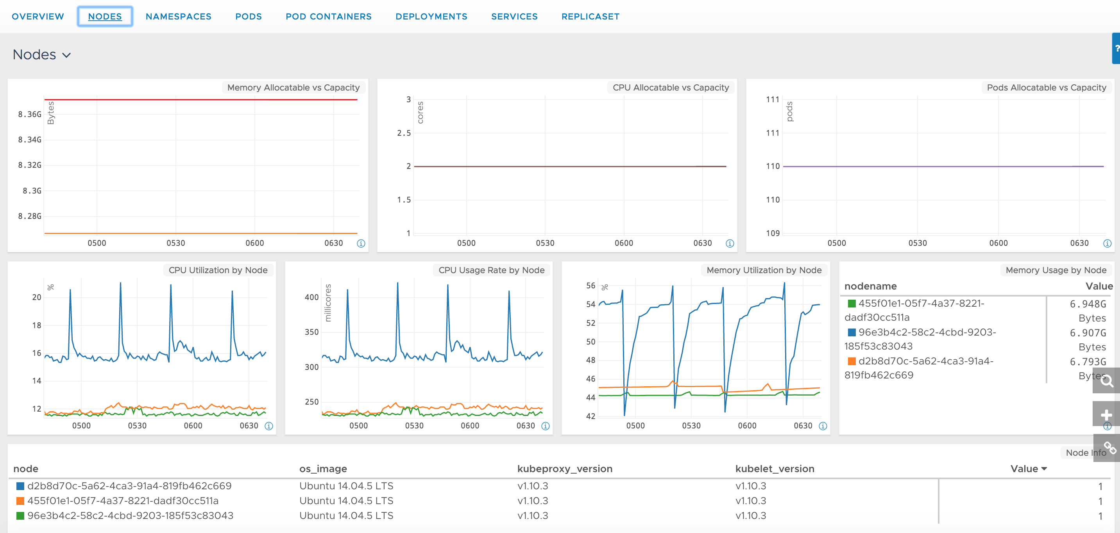
VMware Wavefront
Grafana style dashboard, but no maintenance from you

Slide 24
VMware Wavefront
You can create more alerts with wavefront API
Name | Severity | resolveAfterMinutes
Node Memory Usage high | WARN | 10
Node Memory Usage too high | SEVERE | 10
Node CPU Usage high | WARN | 5
Node CPU Usage too high | SEVERE | 5
Node Storage Usage high | WARN | 10
Node Storage Usage too high | SEVERE | 10
Too many Pods crashing | SEVERE | 5
Too many Containers not running | SEVERE | 5
Node unhealthy | SEVERE | 5

Slide 25
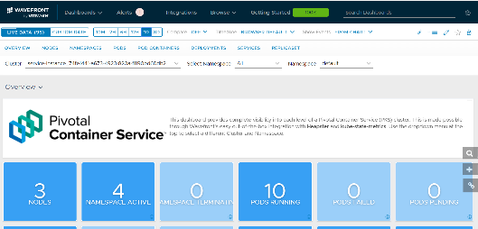
VMware Wavefront
Container based agent
K8s Cluster
Namespace=kube-system
pod=wavefront-proxy
telegraf
wafefront- proxy
node/pod/container status
resource usage
kube-state- metrics
heapster
Master
Worker
Worker
Worker
kube-apiserver
Kubelet
Kubelet
Kubelet

Slide 26
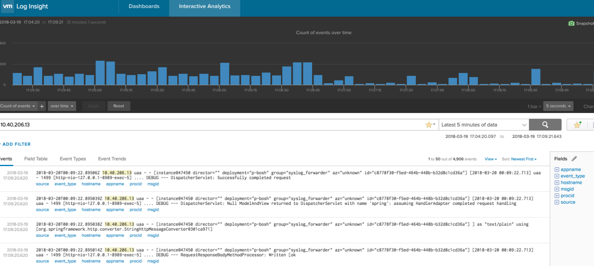
VMware vRealize Log Insight
Opinioned log solution

Slide 27
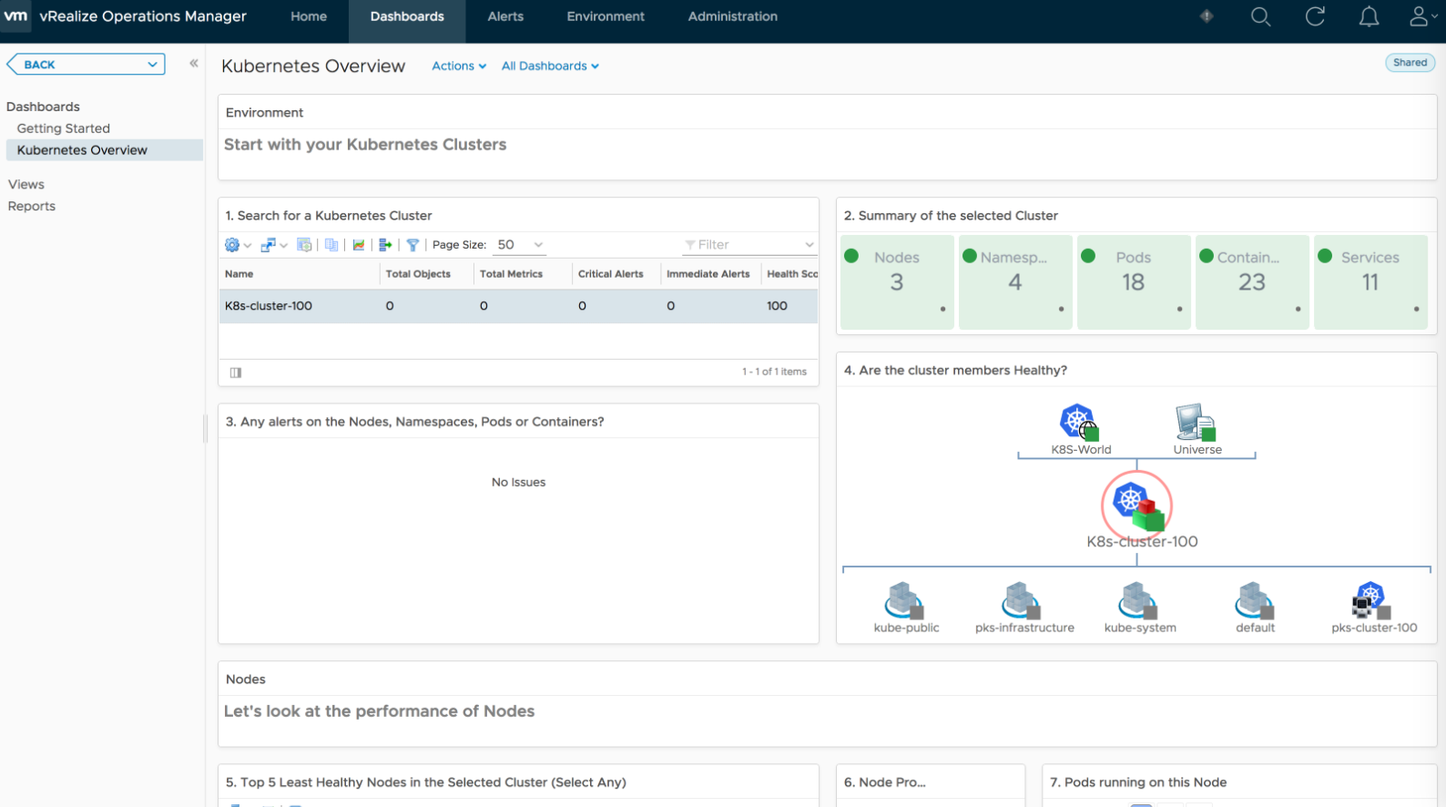
VMware vRealize Operations
Operation & capacity planning

Slide 28
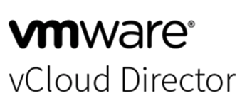
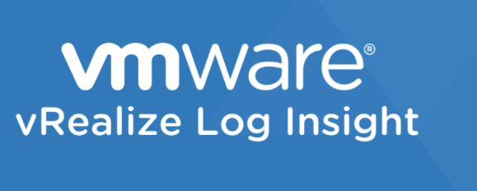
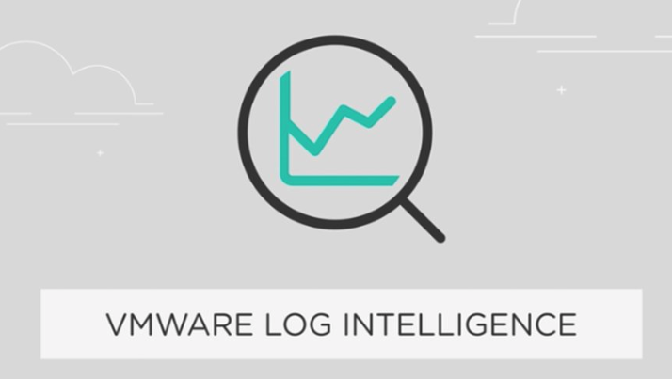
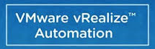
Built-in VMware Solution – More
More VMware products integration for your scenarios

Slide 29



Bring Your Own Solutions
Choose your favorite recipes, or poisons?

Slide 30
Key Takeaway
Benefits you get with PKS
VMware Realize Suite
Easy To Integrate
Namespace Multi-tenancy
Bring Your Own Solution

Slide 31

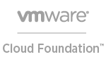


Questions?
Compatible, Conformant Kubernetes
PKS
Enterprise Software
Cloud PKS
Cloud Service
Simplicity
Customization
zdenny@vmware.com

